Slide 1
CS 2212
Introduction to Software Engineering
Chapter 14 Pattern Based Design

Slide 2
Copyright Notice This Presentation and Its Associated Video Contain Copyright Material. This Presentation and Its Associated Video Are Provided for Teaching Purposes of CS2212 and Should Not Be Posted In Any External Site, Or Shared with. This Presentation and Its Associated Video Are Provided For Instructional Personal Use Only, and Only For The Purposes of the CS2212 Course.

Slide 3
Part 41
Behavioral Design Patterns
The goal of Computer Science is to build something that will last at least until we've finished building it.
― Anonymous.
Notes:
This lesson introduces the basic steps in a software engineering project at a high level.
In practice, steps often overlap.

Slide 4
Learning Objectives in this Part
To understand some of the most important Behavioral Design Patterns

Slide 5
Classification of GoF Design Pattern
Creational | Structural | Behavioral
Factory Method Abstract Factory Builder Prototype Singleton | Adapter Bridge Composite Decorator Flyweight Facade Proxy | Interpreter Template Method Visitor Chain of Responsibility Command Iterator Mediator Memento State Strategy Observer
© E. Gamma, R. Helm, R. Johnson, J. Vlissides and Addison-Wesley

Slide 6
Part 41-a
Behavioral Design Patterns – Visitor, Chain of Responsibility, State
Notes:
This lesson introduces the basic steps in a software engineering project at a high level.
In practice, steps often overlap.

Slide 7
Visitor Design Pattern
Intent
Centralize operations on an object structure so that they can vary independently but still behave polymorphically
Applicability
When classes in a collection define many unrelated operations
Class relationships of objects in the structure rarely change, but the operations on them change often
Apply different operations depending the type of object we visit in a collection

Slide 8
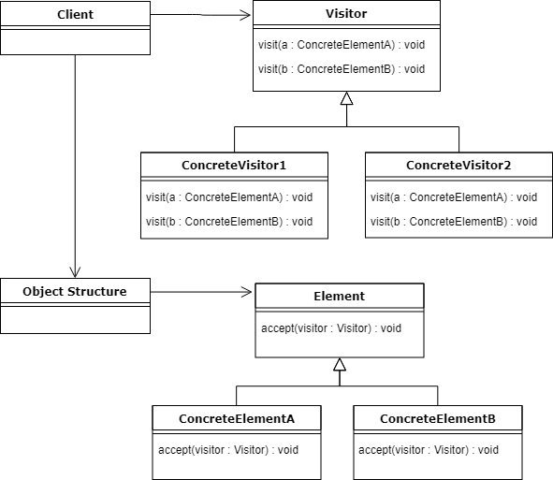
Visitor – Class Diagram
Container
Individual elements

Slide 9
Visitor Design Pattern - Example
// "Visitor"
public abstract class Visitor {
public abstract void visit(JSONElement json);
public abstract void visit(XMLElement xml);
}
// "Element Visitor 1"
public class ElementVisitor1 extends Visitor {
@Override
public void visit(JSONElement json) {
System.out.println("Processing JSON element” +
” with “ + this.getClass().getSimpleName());
}
@Override
public void visit(XMLElement xml) {
System.out.println("Processing XML element” +
“ with “+ this.getClass().getSimpleName());
}
}
//"Element Visitor 2"
public class ElementVisitor2 extends Visitor {
@Override
public void visit(JSONElement json) {
System.out.println("Processing JSON element”
+ “ with " + this.getClass().getSimpleName());
}
@Override
public void visit(XMLElement xml) {
System.out.println("Processing XML element”
+ “with " + this.getClass().getSimpleName());
}
}

Slide 10
Visitor Design Pattern – Example (2)
// "Element"
public abstract class Element {
public abstract void accept(Visitor visitor);
}
// "JSON Element"
public class JSONElement extends Element {
@Override
public void accept(Visitor visitor) {
visitor.visit(this);
}
}
//"XML Element"
public class XMLElement extends Element {
@Override
public void accept(Visitor visitor) {
visitor.visit(this);
}
}
// "Document"
public class Document extends Element{
List<Element> elements = new ArrayList<>();
public void addElement(Element element) {
elements.add(element);
}
@Override
public void accept(Visitor visitor) {
for (Element element : elements)
element.accept(visitor);
}
}
}

Slide 11
Visitor Design Pattern – Example (3)
// Client code
public class MainApp {
public static void main(String[] args) {
// Create two different visitors
Visitor v1 = new ElementVisitor1();
Visitor v2 = new ElementVisitor2();
// Create document with 3 elements
Document d = new Document();
d.addElement(new JSONElement());
d.addElement(new JSONElement());
d.addElement(new XMLElement());
// Visit document with visitors
d.accept(v1);
d.accept(v2);
}
}
Output:
Processing JSON element with ElementVisitor1
Processing JSON element with ElementVisitor1
Processing XML element with ElementVisitor1
Processing JSON element with ElementVisitor2
Processing JSON element with ElementVisitor2
Processing XML element with ElementVisitor2

Slide 12
Visitor Design Pattern – Alternative Example
// "Document"
public class Document extends Element{
List<Element> elements = new ArrayList<>();
public void addElement(Element element) {
elements.add(element);
}
@Override
public void accept() {
for (Element element : elements) {
Visitor visitor = VisitorFactory.create(element);
visitor.visit(element);
}
}
}
Definition of the
class representing the container
changes
Different visitor is created
based on individual element

Slide 13
Design Pattern Chain of Responsibility
Intent
The Chain of Responsibility pattern is used to promote low coupling between the sender of a request and the objects that handle the request. The pattern enables one or more objects to handle the request
Application
The objects that can handle the request are "chained" so that one passes the request to another when and as needed
The result is the request to be able to be managed by one or more objects

Slide 14
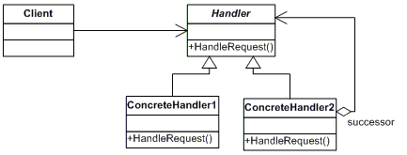
Chain of Responsibility – Class Diagram

Slide 15
Chain of Responsibility – Example
// "Concrete Handler 2"
public class ConcreteHandler2 extends Handler {
@Override
public void handleRequest(int request) {
if (request >= 10 && request < 20) {
System.out.println(
this.getClass().getSimpleName() +
" handled request " + request);
} else if (successor != null) {
successor.handleRequest(request);
}
}
}
// "Concrete Handler 3"
public class ConcreteHandler3 extends Handler {
@Override
public void handleRequest(int request) {
if (request >= 20 && request < 30) {
System.out.println(
this.getClass().getSimpleName() +
" handled request " + request);
} else if (successor != null) {
successor.handleRequest(request);
}
}
}
// "Handler"
public abstract class Handler {
protected Handler successor;
public void setSuccessor(Handler successor){
this.successor = successor;
}
public abstract void handleRequest(int request);
}
// "Concrete Handler 1"
public class ConcreteHandler1 extends Handler {
@Override
public void handleRequest(int request) {
if (request >= 0 && request < 10) {
System.out
.println(this.getClass().getSimpleName() + " handled request " + request);
} else if (successor != null) {
successor.handleRequest(request);
}
}
}

Slide 16
Chain of Responsibility – Client Code
// Client code
public class MainApp {
public static void main(String[] args) {
// Setup Chain of Responsibility
Handler h1 = new ConcreteHandler1();
Handler h2 = new ConcreteHandler2();
Handler h3 = new ConcreteHandler3();
h1.setSuccessor(h2);
h2.setSuccessor(h3);
// Generate and process request
int[] requests = {2, 5, 14, 22, 18, 3, 27, 20};
for (int request : requests) {
h1.handleRequest(request);
}
}
}
Output:
ConcreteHandler1 handled request 2 ConcreteHandler1 handled request 5 ConcreteHandler2 handled request 14 ConcreteHandler3 handled request 22 ConcreteHandler2 handled request 18 ConcreteHandler1 handled request 3 ConcreteHandler3 handled request 27 ConcreteHandler3 handled request 20

Slide 17
State design Pattern
Intent
It allows for an object of a class to change its behavior according to the state it is. This behavior is applied to all such objects which are in the same state. From an outside client it looks like the object has changed class!
Applicability
The State design pattern is useful when we would like the object to be able to denote the different behaviors objects may have when they are in different states (e.g. a robot will move slowly when responds to the command (i.e. method) move if its battery state is low in order to conserve energy, and move fast when the battery state is high)
The design benefit of the State Design Pattern is that the logic which is related to an object’s state is concentrated in the classes that denote the corresponding state

Slide 18
State Design Pattern – Structural Elements
The structural elements (i.e classes) of the State Design Pattern are:
Context
Defines an interface the client code accesses. Such an interface is the method request (see next page)
It associates with an entity that refers to a specific state. The entity is an implementation (e.g. ConcreteStateΑ, ConcreteStateΒ) of a class that inherits from the class State.
State
Defines the interface that encapsulates the behavior for a specific state of a context. This interface is the method Handle
Concrete State
It is the subclass of State which implements using polymorphism the behavior that is associated with a given Context.

Slide 19
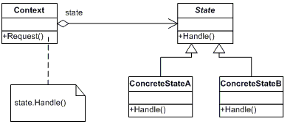
State Design Pattern – Class Diagram

Slide 20
State Design Pattern - Example
// "State"
public abstract class State {
public abstract void handle(Context context);
} // "Concrete State A"
public class ConcreteStateA extends State {
@Override
public void handle(Context context) {
context.setState(new ConcreteStateB());
}
} // "Concrete State B"
public class ConcreteStateB extends State {
@Override
public void handle(Context context) {
context.setState(new ConcreteStateA());
}
}
// "Context"
public class Context {
private State state;
public Context(State state) {
this.state = state;
}
public void setState(State state) {
System.out.println("State: " +
state.getClass().getSimpleName());
this.state = state;
}
public State getState() {
return state;
}
public void request() {
state.handle(this);
}
}

Slide 21
State Design Pattern – Client Code Example
// Client code
public class MainApp {
public static void main(String[] args) {
// Setup context in a state
Context c = new Context(new ConcreteStateA());
// Issue requests, which toggles state
c.request();
c.request();
c.request();
c.request();
}
}
Output:
State: ConcreteStateA State: ConcreteStateB State: ConcreteStateA State: ConcreteStateB State: ConcreteStateA

Slide 22
Part 41-b
Behavioral Design Patterns - Strategy
Notes:
This lesson introduces the basic steps in a software engineering project at a high level.
In practice, steps often overlap.

Slide 23
Strategy Design Pattern
Intent
Design a family of algorithms which can be called through a well defined common interface, so that the client programs and the algorithms that can be called can change independently
Applicability
When an object should associate with one or more algorithms to perform a task, and the algorithms can be encapsulated, and a common interface can be used to call all these different algorithms

Slide 24
Strategy Design Pattern – Class Diagram

Slide 25
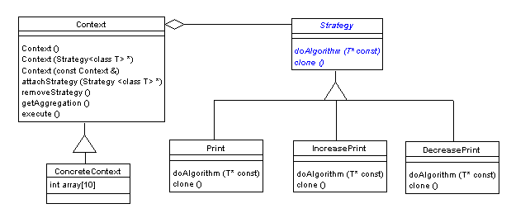
Strategy Design Pattern – Class Diagram

Slide 26
Strategy – Example (1)
// "Context"
public class Context {
private Strategy strategy;
private Integer[] array = new Integer[]
{5, 4, 9, 1, 8, 3, 2, 7, 0, 6};
public Context(Strategy strategy) {
this.strategy = strategy;
}
public Integer[] getArray() {
return array;
}
public void setStrategy(Strategy strategy) {
this.strategy = strategy;
}
public void execute() {
strategy.doAlgorithm(this);
}
}
// "Strategy"
public abstract class Strategy {
public abstract void doAlgorithm(Context context);
}
// "Simple Print Strategy"
public class SimplePrintStrategy extends Strategy {
@Override
public void doAlgorithm(Context context) {
// Get array to print
Integer[] array = context.getArray();
System.out.println("Simple Print: " + array);
}
}
// "Increase Print Strategy"
public class IncreasePrintStrategy extends Strategy {
@Override
public void doAlgorithm(Context context) {
// Get array to print
Integer[] array = context.getArray();
// Sort array in ascending order
Arrays.sort(array);
System.out.println("Increase Print: " + array);
}
}

Slide 27
Strategy – Example (2)
// "Decrease Print Strategy"
public class DecreasePrintStrategy extends Strategy {
@Override
public void doAlgorithm(Context context) {
// Get array to print
Integer[] array = context.getArray();
// Sort array in descending order
Arrays.sort(array, Collections.reverseOrder());
System.out.println("Decrease Print: " + array);
}
}

Slide 28
Strategy – Client Code Example (3)
// Client code
public class MainApp {
public static void main(String[] args) {
// Create a context with simple printing strategy
Context context = new Context(new SimplePrintStrategy());
context.execute();
System.out.println("***********************");
// Change the strategy to increasing
context.setStrategy(new IncreasePrintStrategy());
context.execute();
System.out.println("***********************");
// Change the strategy to decreasing
context.setStrategy(new DecreasePrintStrategy());
context.execute();
System.out.println("***********************");
}
}
Output:
Simple Print: {5, 4, 9, 1, 8, 3, 2, 7, 0, 6}
********************************* Increase Print: {0, 1, 2, 3, 4, 5, 6, 7, 8, 9}
********************************* Decrease Print: {9, 8, 7, 6, 5, 4, 3, 2, 1, 0}
*********************************

Slide 29
Strategy - Comments
Consequences
Flexibility, code reuse
We can dynamically at run time change the algorithms that can be called from the client code
Cost to associate algorithms to objects
Need for common interface for all algorithms used (Inflexible strategy interface)
Implementation
Need to pass data between the algorithm (strategy) and the corresponding object (context)

Slide 30
Part 41-c
Behavioral Design Patterns - Observer
Notes:
This lesson introduces the basic steps in a software engineering project at a high level.
In practice, steps often overlap.

Slide 31
Observer Design Pattern
Intent
Define a one-to-many dependency between objects so that when one object (i.e. the subject) changes state, all its dependents (i.e. observers) are notified and updated (or perform an operation) automatically.
Applicability
When an abstraction has two aspects, one dependent on the other.
When a change to one object requires changing others, and you don't know how many objects need to be changed.
When an object should notify other objects without making assumptions about who these objects are.

Slide 32
Observer Design Pattern (Cont'd)
Consequences
Modularity: subject and observers may vary independently
Extensibility: can define and add any number of observers
Customizability: different observers provide different views of subject
Unexpected updates: observers don't know about each other
Update overhead: might need hints
Implementation
Subject-observer mapping
Dangling references
Avoiding observer-specific update protocols: the push and pull models
Registering modifications of interest explicitly
© E. Gamma, R. Helm, R. Johnson, J. Vlissides and Addison-Wesley

Slide 33
Observer Design Pattern (Cont'd)
Known uses
Smalltalk model-view-controller (MVC)
Interviews (subjects and views)
Andrew (data objects and views)
Benefits
Design reuse
Uniform design vocabulary
Enhance understanding, restructuring
Basis for automation
© E. Gamma, R. Helm, R. Johnson, J. Vlissides and Addison-Wesley

Slide 34
Observer – Class Diagram

Slide 35
Observer - Example (1)
// "Subject"
public abstract class Subject {
private List<Observer> observers = new ArrayList<>();
public void attach(Observer observer) {
observers.add(observer);
}
public void detach(Observer observer) {
observers.remove(observer);
}
public void notifyObservers() {
for (Observer observer : observers)
observer.update(this);
}
}
// "Observer"
interface Observer {
public void update(Subject subject);
}
// " Clock Timer"
public class ClockTimer extends Subject {
private int hour, minute, second;
public int getHour() {
return hour;
}
public int getMinute() {
return minute;
}
public int getSecond() {
return second;
}
public void tick() {
// Update internal time-keeping state
// ...
notifyObservers();
}
}

Slide 36
Observer – Example (2)
// "Digital Clock"
public class DigitalClock implements Observer {
private ClockTimer subject;
public DigitalClock(ClockTimer subject) {
this.subject = subject;
subject.attach(this);
}
@Override
public void update(Subject changedSubject) {
if (changedSubject.equals(subject))
draw();
}
private void draw() {
int hour = subject.getHour();
int minute = subject.getMinute();
int second = subject.getSecond();
// Digital draw operation
System.out.println("Drawing digital clock!");
}
}
// "Analog Clock"
public class AnalogClock implements Observer {
private ClockTimer subject;
public AnalogClock(ClockTimer subject) {
this.subject = subject;
subject.attach(this);
}
@Override
public void update(Subject changedSubject) {
if (changedSubject.equals(subject))
draw();
}
private void draw() {
int hour = subject.getHour();
int minute = subject.getMinute();
int second = subject.getSecond();
// Analog draw operation
System.out.println("Drawing analog clock!");
}
}

Slide 37
Observer – Client Code
// Client code
public class MainApp {
public static void main(String[] args) {
// Creating timer
ClockTimer timer = new ClockTimer();
// Initializing timer's observers
AnalogClock analogClock = new AnalogClock(timer);
DigitalClock digitalClock = new DigitalClock(timer);
// Changing the time in timer
timer.tick();
}
}
Output:
Drawing digital clock!
Drawing analog clock!

Slide 38
Your Turn
What is the difference between the State pattern and the Strategy pattern? In which situations each one is best to be used for?
What is the difference between the State pattern and the Adapter pattern? In which situations each one is best to be used for?
What is the difference between the Adapter pattern and the Strategy pattern? In which situations each one is best to be used for?
Give two examples for using the Chain of Responsibility design pattern. Explain the use of the pattern in your examples.
Give two examples for using the Visitor design pattern. Explain the use of the pattern in your examples.
Check-out the content of the following sites:
https://howtodoinjava.com/design-patterns/
https://en.wikipedia.org/wiki/Adapter_pattern
https://en.wikipedia.org/wiki/State_pattern
https://en.wikipedia.org/wiki/Strategy_pattern
https://en.wikipedia.org/wiki/Visitor_pattern
https://en.wikipedia.org/wiki/Chain-of-responsibility_pattern

